Slide 1
Decentralized Application Client Layer
Blockchain Life Forum 202x
Max Ryazanov

Slide 2
Internet Layers
Client Applications
Web Browsers
User layer
Client-side
Front-end
Business/storage
layer
Server-side
Back-end
Servers
dApps

Slide 3
What We Are Going to Change
Client Applications
Web Browsers
User layer
Client-side
Front-end
Business/storage
layer
Server-side
Back-end
Servers
dApps

Slide 4
Pros and Cons
of Today’s
Client Application Technologies

Slide 5
The Web Applications
Pros
Ease of use
Platform independence
Malware resistance
Cons
Requires a Web server
DDOS vulnerability
Censorship vulnerability
Hacker vulnerability
Low application performance
Relatively poor UI
http://www....

Slide 6
The Client Applications
Desktop and Mobile
Application…
X
Pros
High performance
Full access to resources
Rich UI
Cons
Platform dependence
Long time to interact (TTI)
An installation required
Vulnerability to malware

Slide 7
The Decentralized Applications
Still not fully decentralized as they require a separate client layer
(website or client application)
Client layer
(Web servers,
app stores)
dApp
platforms

Slide 8
The Dream
Universal applications that are as easily accessible as Web pages but have the performance and UI power of installable programs,
and which live in a homogenous network
without centralized servers

Slide 9
The Requirements
Easy as Web
Safe
Decentralized
Platform-independent
High performance
Rich unified UI
Ready for current and future devices

Slide 10
Decentalized Web Servers?
High node hardware requirements
Difficulties with a load balancing and session synchronization
Existing P2P solutions work for static content only.

Slide 11
The Bold Move
Move away from the Web paradigm...
HTTP, HTML, JS, …

Slide 12
The Bold Move
...and go with the advanced client software paradigm.
Can be delivered in a decentralized manner
Can work directly with dApps
Highest performance and rich UI

Slide 13
The Related Technologies
P2P
Silverlight
IPFS
Flash
Bittorrent
Virtualization
DNS
Virustotal
ENS
ActiveX
dApp
Mobile OS
Namecoin

Slide 14
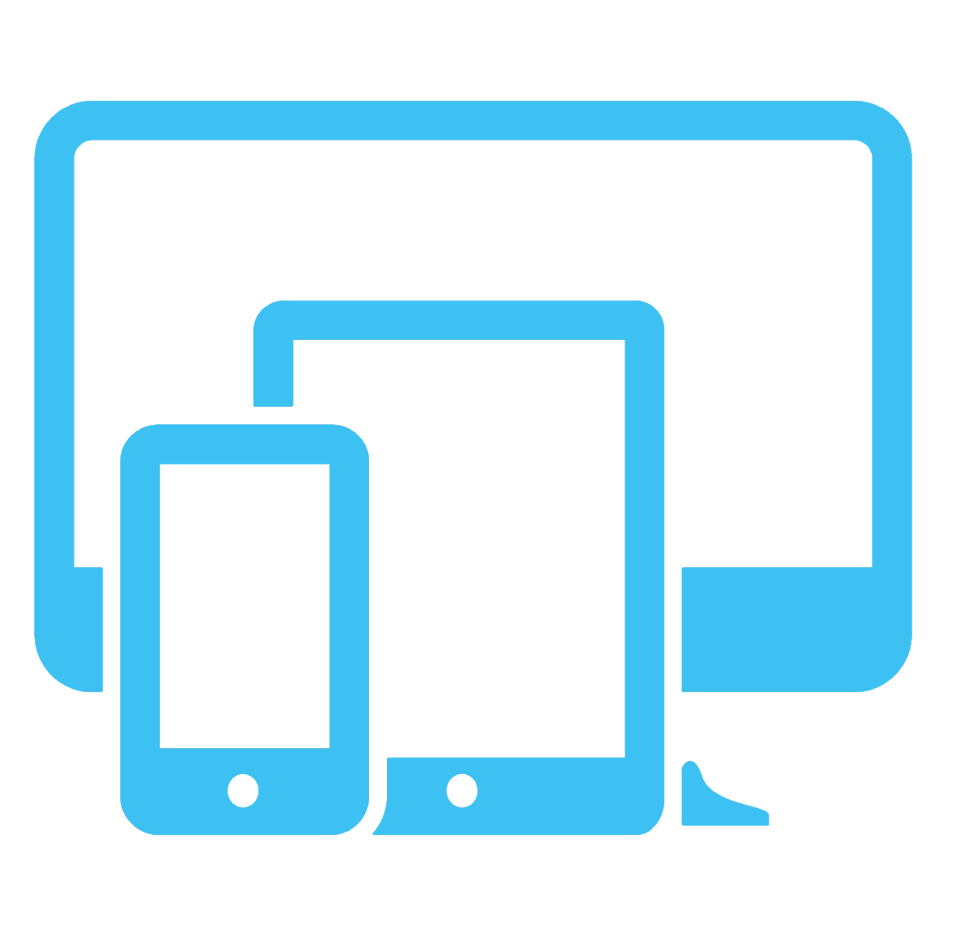
The Major Challenges
Time to interact (TTI). The initial size of client applications is usually much bigger than the size of a Web page.
Web code is intrinsically safe for a user system, whereas desktop and mobile applications are two of the major channels for malware spread.
Software vendors have to develop a separate applications, ideally, for all major platforms including Web – and so have to incur extra expenses

Slide 15
First Major Challenge
How to minimize the time to interact

Slide 16
First Major Challenge
How to minimize the time to interact
The solution is: P2P + small initial size

Slide 17
IPFS as a Resource Delivery Network
Decentralized publishing, distribution and delivery
Fast and reliable
Free to participate
No censorship
Already live

Slide 18
Minimizing Initial Size
!
Core
Required to start application components
!
!
Deferred
Can be downloaded in background after application is started
Optional
Plug-ins, add-ons, rarely used features
Shared
Different applications can use the same components.

Slide 19
Distribution Management System
Decentralized cryptography-based registry
Permission-less
Publishing (Name-IpfsID binding)
Versioning
Anti-malware Certification
Searching

Slide 20
Second Major Challenge
1. We are going to distribute a code that can have full access to a user system.
How do we prevent a user system from being damaged
in the event of a malware-infected application?
2. Downloadable applications can be quite large.
We need some reliable and fast way to check malware status
of software before downloading it.

Slide 21
The solution is: multi-level protection.
Isolation
Verification
Reputation

Slide 22
Multi-Level Protection
“Stay safe.”
Run applications in an isolated and virtualized environment, similar to mobile OSs.
“Is it clean?”
Rapid anti-malware verification before downloading
“Who is the publisher?”
Determines a level of trust based on publisher information and activity.
3 - Isolation
2 - Verification
1 - Reputation

Slide 23
Reputation and Verification
Analyzing each application release for malware presence by trusted third parties and publishing the report. User needs only to get and check results.
Verification
Reputation
White lists of known publishers – as “root certificates”
Statistics based on malware status of the whole release history

Slide 24
Anti-Malware Protection Protocol
Distribution Management System
Resource Delivery Network
App Release | Analysis Report
App v1.2.3 Windows | ipfs://QmNrgEMc
App v1.2.3 macOS | Ipfs://QmKdjdiv
… | …
Analyzer | Status
0x123… | Clean
0x456… | Clean
0x789… | Infected/Trojan
… | …
Blockchain Record
Analysis Report

Slide 25
How Verification Level Works

Slide 26
Step 1: Publication
App
release
files
Publisher
Resource Delivery Network
App | Version | Platform | RDN Id | …
Distribution Management System

Slide 27
Step 2: Request Verification
Third-party
malware analysis
companies
App Release
RDN Id
Publisher

Slide 28
Step 3: Verification
Third-party
malware analysis
companies
App files
Reports
Resource Delivery Network

Slide 29
Step 4: Publication of Analysis Report
Combined Report
File
Reports
Resource Delivery Network
Product Release ID | Analysis Report
App v1.2.3 Win7+ | ipfs://QmNrgEMc
Distribution Management System

Slide 30
Step 5: Download
App files
Resource Delivery Network
Users
Combined Report
File

Slide 31
Step 6: Checking and Execution
Application
Clean
No data
Infected!
Safe to execute as an isolated or system application
“Application is not verified.
Are you sure you want to proceed?”
Block execution.

Slide 32
Third Major Challenge
How to minimize the development cost

Slide 33
Execution Environment
Isolation and virtualization
Application
Unified API
Unified UI

Slide 34
Execution Environment
Responsibilities
Run applications without installation/uninstallation
Platform-independent unified API
Isolated execution environment, like a virtual machine or “sandbox”
UI Layer
Provides platform-independent and adaptable UI technology
A single environment that user can interact with via different devices with desktop-grade UI capabilities.
Can work on desktop and mobile devices as well as on modern and future VR gears.

Slide 35
Economy Benefits
It is completely free to use for all users.
Publishers have to pay a small fees only for publishing and verification
Verification stage is optional but significantly increases trust in published software
A big, new market for antivirus companies

Slide 36
Freedom Benefits
It is not possible to ban a particular publisher or application as it does not rely on a specific DNS record or IP address. Even publishers have no power to restrict users from using their software.
Utilizing various dApp platforms as the application server-side (back-end) and Ultranet as the application client-side (front-end) gives rise to an ecosystem that is invulnerable to DDOS attacks. Moreover, Ultranet proposes a special protocol that is capable of actively shutting down any botnet that participates in such types of attack.
DMS cryptography replaces the need of code-signing certificates

Slide 37
Performance Benefits
The infrastructure does not require high performance BFT protocol - even existing solutions are already powerful enough for all Ultranet functions.
Global unique identifiers of shared software components allow to avoid downloading the same files more than once thus minimizing TTI and the whole Internet traffic
Users no longer need to have antivirus installed locally, sacrificing the performance of their hardware.

Slide 38
Opportunities
Various decentralized software stores can be built on top of
The technology provides a unified mechanism to update applications so that no special development efforts are required to support auto-updating.
RDN + DMS = Global Software Registry as a unified replacement for various package/component/library databases – and not only for a code.
Utilizing antimalware companies’ specialized infrastructure makes it possible to perform a much deeper (AI) and more comprehensive analysis of application code.
Together with distributed file systems (clouds, Sia, Chia, Swarm, Storj, etc.), the technology enables server-less thin clients. In this case both the applications and user data are stored remotely in a decentralized manner.

Slide 39
Complete Decentralization
Resource Delivery Network
Distribution Management System
Competely
Decentralized
Applications
dApp platforms

Slide 40
ULTRANET
https://ultranet.org

